Slide 1

Soft Core Practical Project : PokeDex
By Viraj Patel

Slide 2
Introduction
Graduated from De Monfort University in 2020 in Computing For Business
Tasked to complete this API Project
Approached by creating SpringBoot API, adding mySQL local instance, creating HTML which loads data using javascript

Slide 3
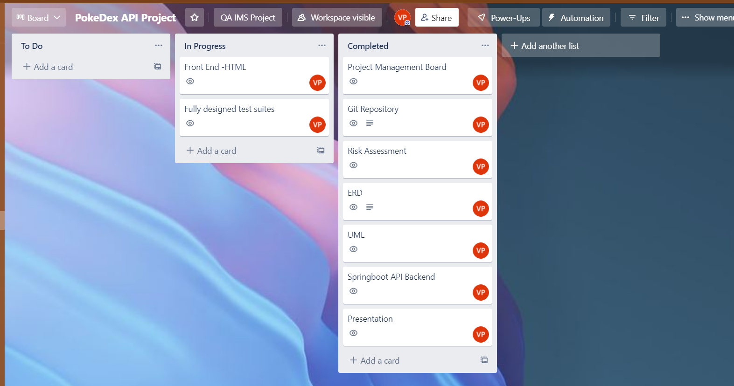
Project Management Board

Slide 4
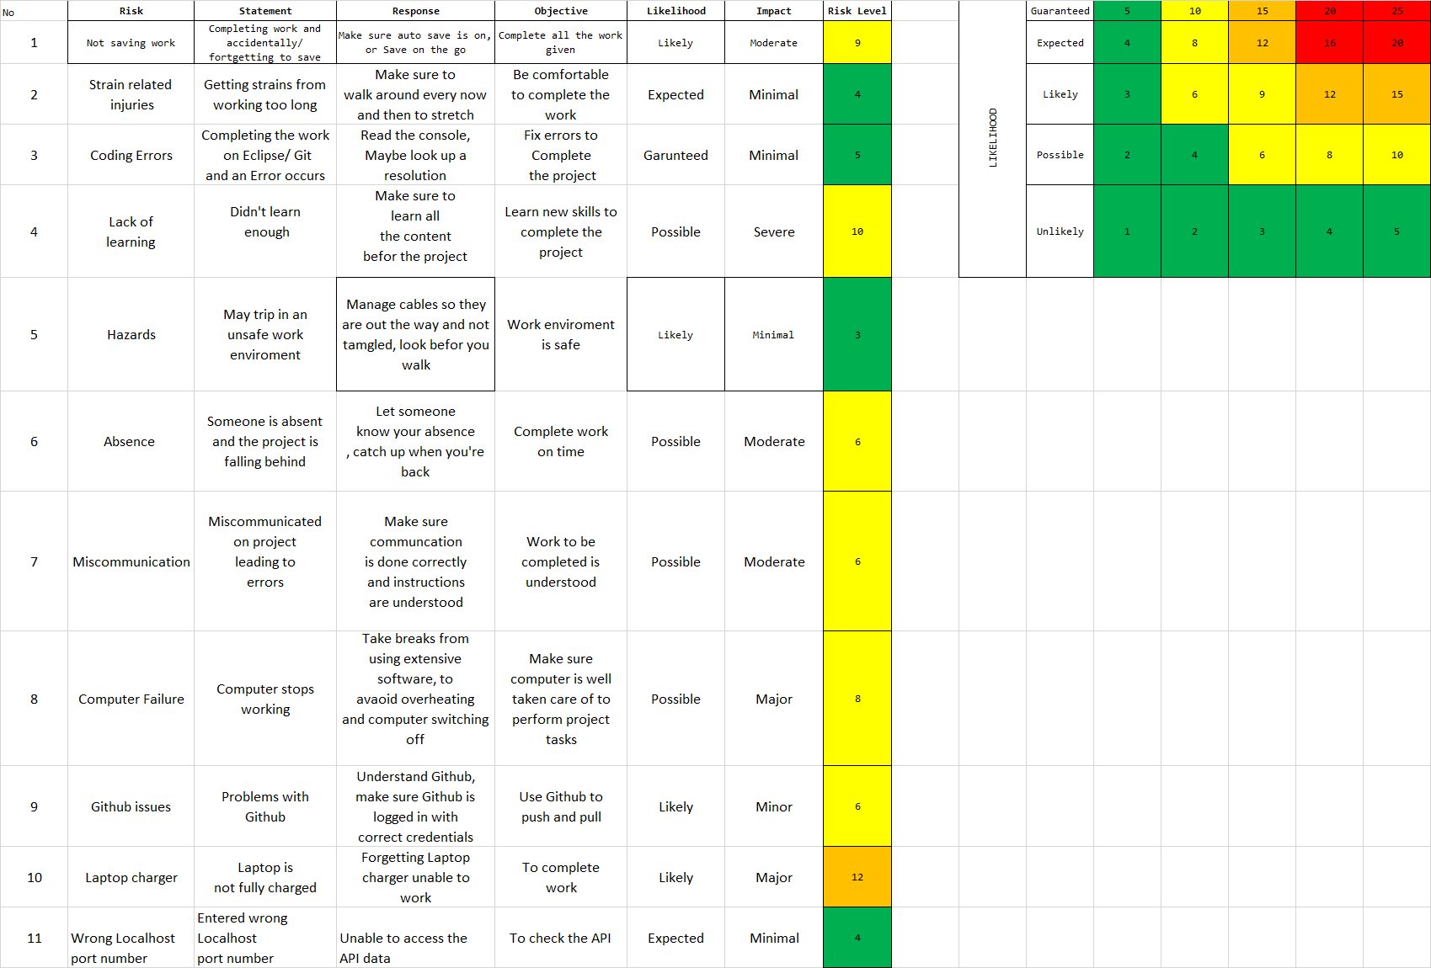
Risk Assessment

Slide 5
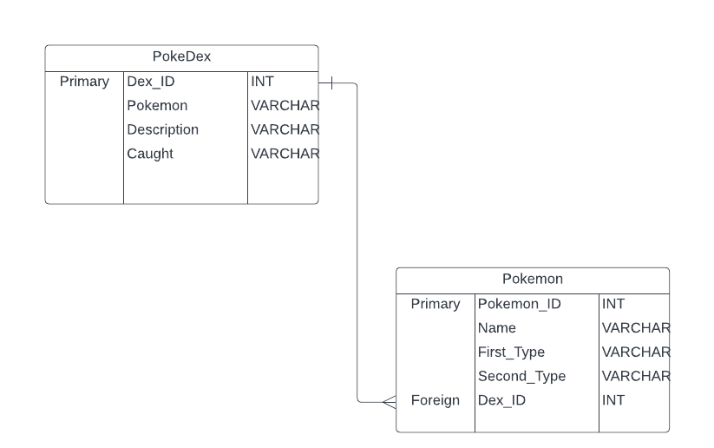
ERD

Slide 6
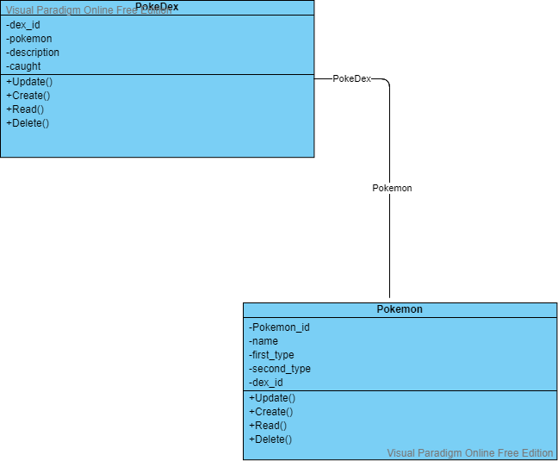
UML

Slide 7
CI
Updated git on a table basis

Slide 8
Consultant Journey
Java Eclipse – Spring Boot
Github Bash
SQL and MySQL Workbench
Trello
Lucid Chart
JavaScript, HTML, CSS

Slide 9
Demonstration

Slide 10
Sprint Review
Completed most of the functionality
Missed out of fetch data from the API to HTML page

Slide 11
Sprint Retrospective
The functionality went well, got the main API to work and the connection between SpringBoot and the localhost worked
Understanding improved, of most concepts
Time management – could have finished my data fetching and designing my HTML page

Slide 12
Conclusion
Understand the concept sooner
Use my time more wisely
Orgainisational skills to be improved

